Slide 1
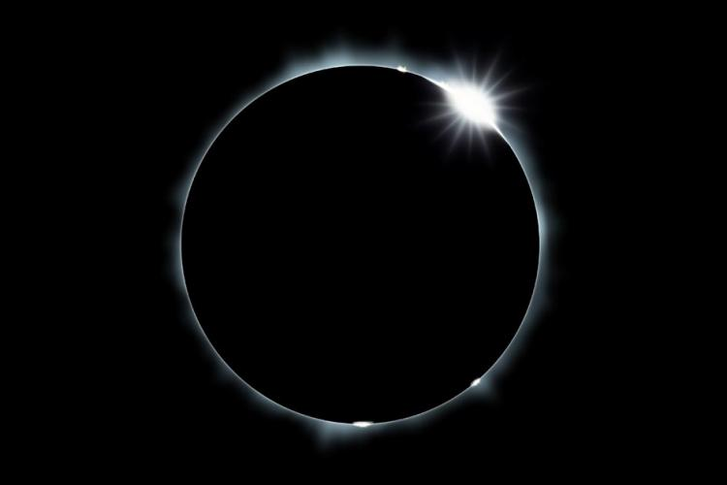
Astronomy 195: The Great North American Eclipse of 2024
© Gerard Williger 2023 U Louisville
Goals:
Understand HOW/WHY THEY WORK
Understand THEIR HISTORY
Understand WHAT WE LEARN FROM THEM
Understand HOW SEEN IN CULTURE
KNOW HOW TO OBSERVE/ENJOY THEM

Slide 2
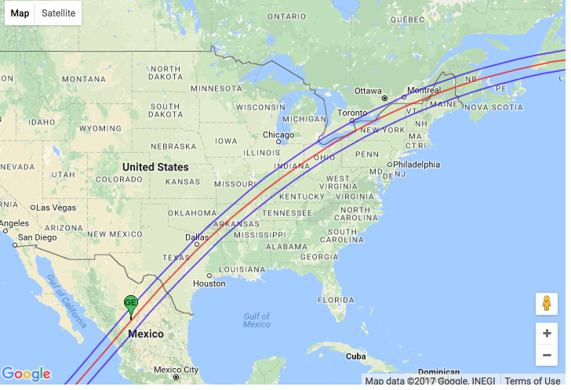
The Apr 8, 2024 Total Solar Eclipse
© Gerard Williger 2023 U Louisville
See animation for this solar eclipse

Slide 3
Buy Eclipse Glasses/Filters
© Gerard Williger 2023 U Louisville
Buy them NOW!
Total eclipse Apr 8, 2024
Prices will RISE FAST, availability may decrease!
To be safe, use eclipse glasses <3-4 years old.
SHEETS: Order sheets of mylar filters (for cameras, binoculars)
Club together with classmates as you like
Also recommend Seymour Solar
See also Am. Astron. Soc. (AAS) site
or Daystar Filters
GLASSES: Soc of Physics Students planning to bulk order at least 500

Slide 4
Class Introductions
© Gerard Williger 2023 U Louisville
Your name, field/major, career plans or current job
Tell us about your previous eclipse experiences, if any
Tell us about chances for doing teaching or public outreach: classroom, tutor Astro 195 in spring, outreach with the Soc. Of Physics Students, talk about eclipse in your group/department etc.

Slide 5
Videos of Past Eclipses
© Gerard Williger 2023 U Louisville
Your thoughts on the 2017 Eclipse (discussion)
Aug 31, 1932 (30”), New England
Jul 20, 1963 (1’), high above Manitoba
Feb 26, 1979 (2’), Brandon MB
Aug 21, 2017 (0.7’), Columbia SC
Aug 21, 2017 (1’), Carbondale IL

Slide 6
Summary: How Eclipses Happen
© Gerard Williger 2023 U Louisville
It’s All Perspective! Motions:
I. Daily, Earth: Rotation
Sun rises in east, sets in west in 24 hours
II. Monthly, Moon: Phases
Moon goes through constellations in 29 days
III. Annual, Earth: Revolution
Sun goes through constellations in 365 days
Sun ALSO moves north and south in sky
Angles and Distances
Astronomy Scales

Slide 7
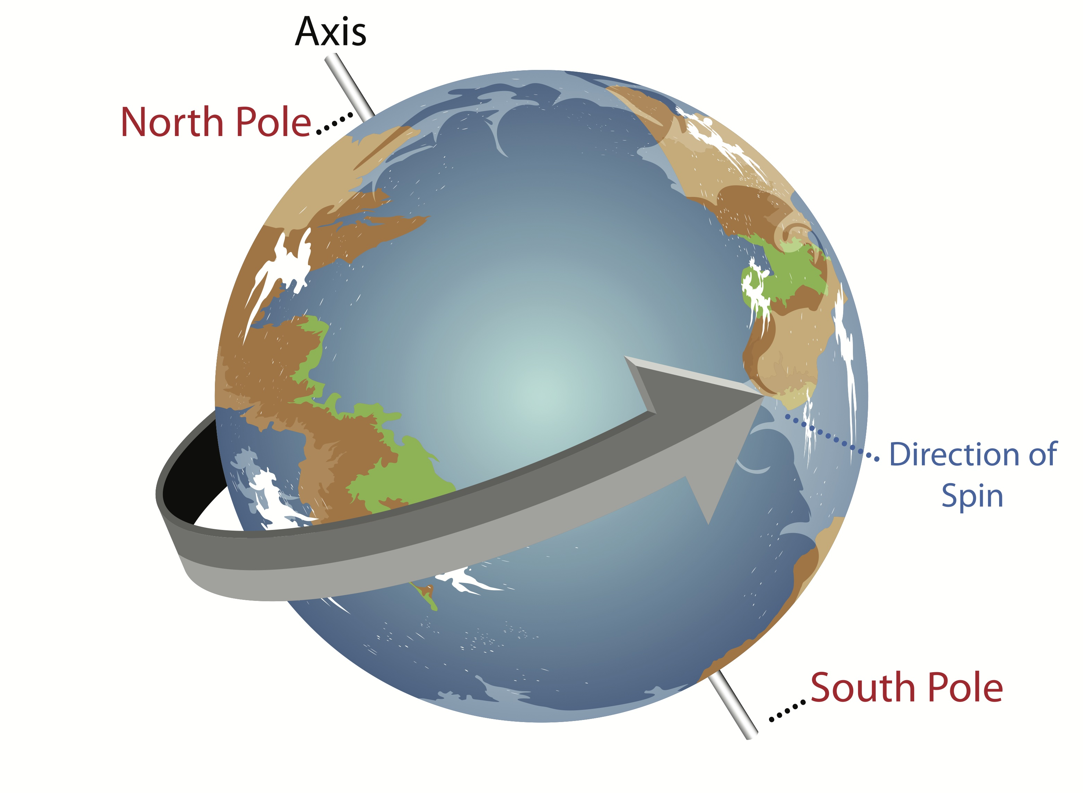
Star, Sun, Moon, Planet Motions DAILY Motion
© Gerard Williger 2023 U Louisville
Earth rotates on its axis from WEST to EAST once per day (clockwise viewed from north), so stars, the sun, moon and planets appear to RISE IN THE EAST and SET IN THE WEST ”reflex motion”. WE are spinning fast compared to any motion they have. 1’ video link
Image source LINK

Slide 8

Star, Sun, Moon, Planet Motions ANNUAL Motion
© Gerard Williger 2023 U Louisville
Similarly, Earth orbits the sun (counterclockwise viewed from north) also going from WEST to EAST once per YEAR, so stars in the sky appear to MOVE SLOWLY TO THE WEST rel. to Sun.
→ Stars rise 4 minutes early every day relative to the Sun. 4 minutes = 1/365th of a day. This is 2 hrs earlier each month.
Sun makes a circle in sky every 24 hrs (how we measure time), so stars make a circle in sky every 23 hrs 56 min.
3’ video link
1 day of Earth’s orbit (1/365 of circle)
Sun
To distant star
Note: most figures NOT to scale!
So Sun appears to move EAST compared to stars, 1/365th of a circle/day

Slide 9
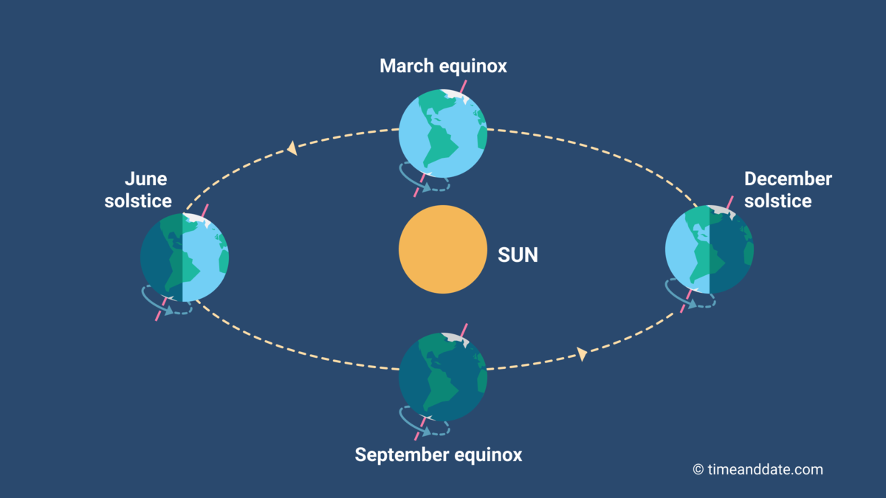
Earth’s Tilt
© Gerard Williger 2023 U Louisville
SUMMARY: Earth has two motions:
(a) rotation on axis (spins once per day = FAST)
(b) revolution around sun (1 orbit per year = SLOW)
These two motions are AT AN ANGLE TO EACH OTHER of 23.5 degrees, with the two motions superimposed
→ SEASONS
→ Sun appears to move slowly N and S on sky over year, also slowly to East, relative to the stars
NOT to scale!

Slide 10
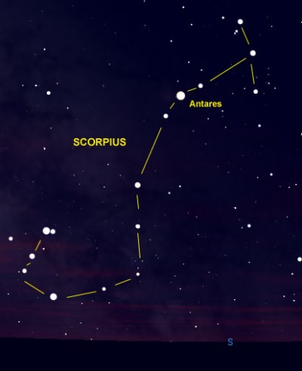
Constellations – origins
© Gerard Williger 2023 U Louisville
Stars - at different distances
We can’t tell distances to stars with our eyes!
Different cultures: many stories about groups of stars → constellations.
Sometimes resembled something (Scorpius, the Scorpion), but mostly to honor a hero/story character.
Constellations vary from culture to culture!

Slide 11
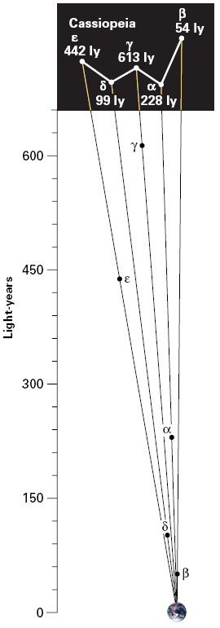
Constellations – cosmic addresses
© Gerard Williger 2023 U Louisville
International Astronomical Union set constellation boundaries in 1930.
88 constellations, every star is in one constellation.
48 from Claudius Ptolemy (Greek astronomer, 1st century AD)
constellations -- only the directions to stars, today, from Earth’s point of view
Stars in a constellation: usually at quite different distances
Stars not physically associated with each other
Born at different times and locations.

Slide 12
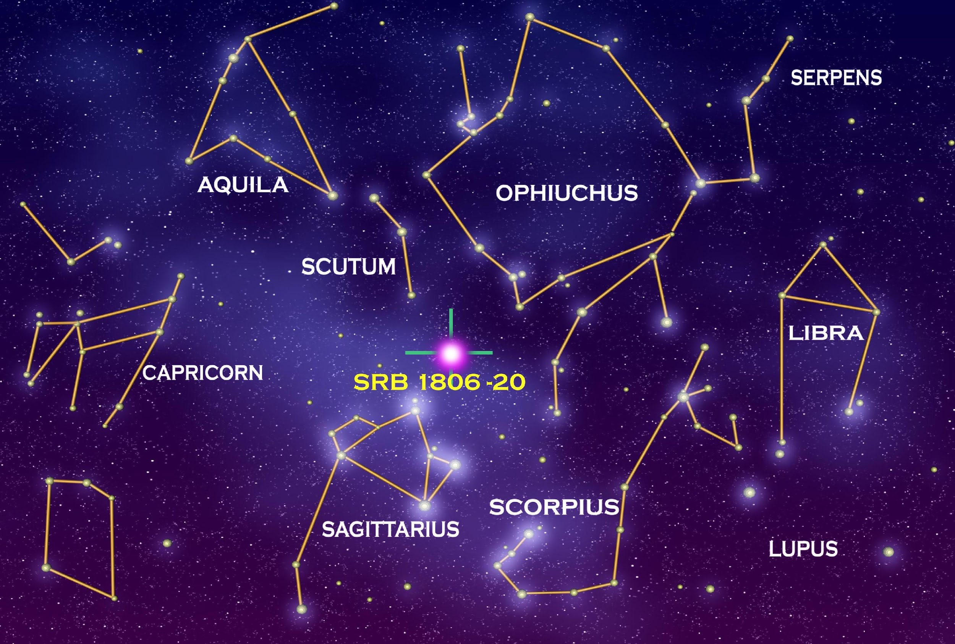
A few of the 88 Constellations
© Gerard Williger 2023 U Louisville
Part of AQUARIUS
Outskirts of
MICROSCOPIUM

Slide 13
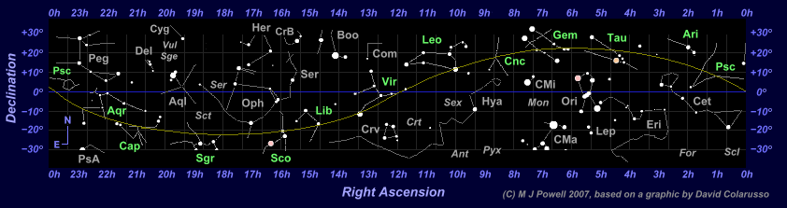
Celestial Latitude/Longitude
© Gerard Williger 2023 U Louisville
Celestial Latitude called “Declination”
-- above Earth’s parallels of latitude
Celestial Longitude called “Right Ascension”
Extension of Earth’s equator = “Celestial Equator”

Slide 14
Sun’s annual motion along stars
© Gerard Williger 2023 U Louisville
Sun moves to EAST with respect to stars, about 1 deg/day
Sun’s path on sky = plane of Earth’s orbit = “Ecliptic” – runs through constellations of ZODIAC (abbreviations in green)
Mar 21 Dec 21 Sep 21 Jun 21 Mar 21
← East on the sky

Slide 15
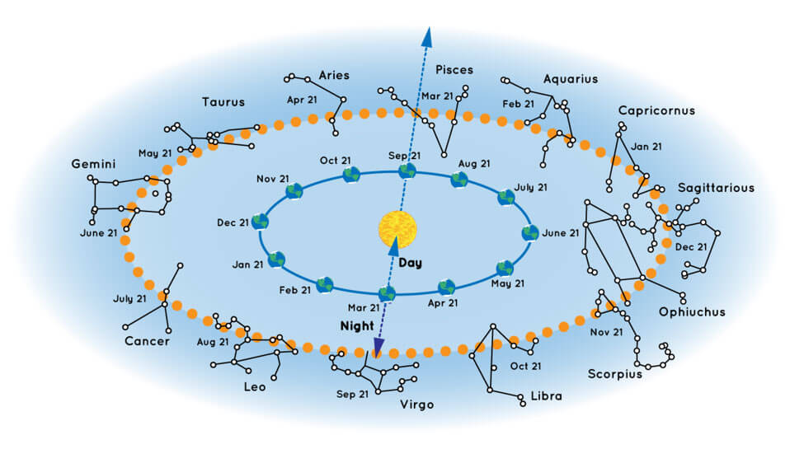
Result: We see Seasonal Constellations
© Gerard Williger 2023 U Louisville
Note: dates differ from “astrology” – it’s 2000 years out of date!
Viewed from an angle toward north of Earth’s orbit
RA=0 hrs
RA=6 hrs
midnight
RA=18 hrs
noon
noon
midnight
These are the constellations of the ZODIAC
RA=12 hrs
On Sep 21, from Earth, the Sun appears in front of Pisces, and when we look up at midnight (opposite the Sun), we see Virgo.

Slide 16
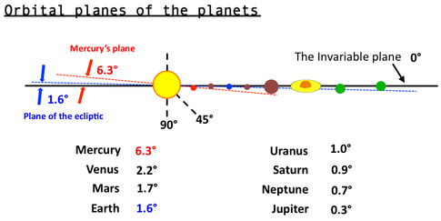
What about the Moon? Planets?
© Gerard Williger 2023 U Louisville
Seven of the eight planets orbit within 2.2 deg of Earth’s orbital plane! The Moon’s orbit is inclined by 5.1 deg from Earth’s orbital plane.
The Moon does NOT orbit over Earth’s equator!
Moon 5.1∘
Earth’s orbit
The Sun, Moon and planets all go through the constellations of the ZODIAC.

Slide 17
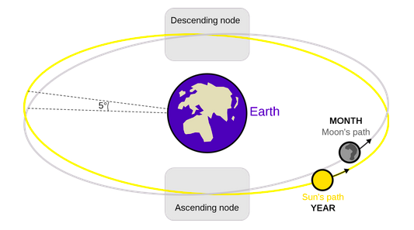
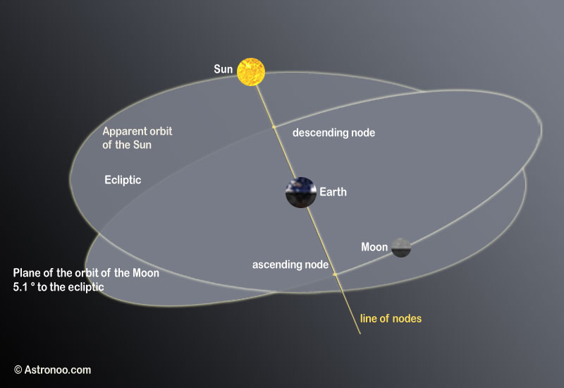
Moon is always <5∘ of Sun’s path
© Gerard Williger 2023 U Louisville
But many things must go right for an eclipse!
Moon crosses ecliptic, N to S
Moon crosses ecliptic, S to N
None of this is to scale!

Slide 18
Moon’s Monthly motion along stars
© Gerard Williger 2023 U Louisville
Moon moves to EAST with respect to stars, about 13 deg/day – FAST!
-- moves 1 Moonwidth/hour relative to stars
-- rises 50 minutes LATER per day
-- within +/- 5 deg of Ecliptic
Sun’s path on sky = plane of Earth’s orbit = “Ecliptic” – goes through ZODIAC
← East on the sky
Mar 28 Mar 21 Mar 14 Mar 7 Mar 1
New Moon 3rd Quarter Full Moon 1st Quarter New Moon

Slide 19
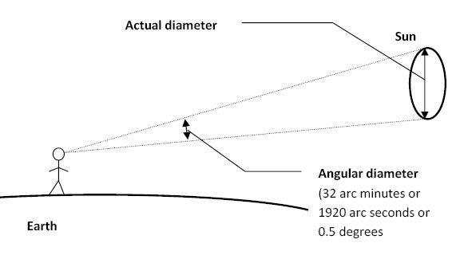
Key Points: Angles and Distances
© Gerard Williger 2023 U Louisville
DISTANCES in space are HARD to measure. Astronomers usually can only measure ANGLES.
Angles: 360 deg/circle; 60 arcminutes per degree (and 60 arcseconds per arcmin)
Rules of “thumb”:
- Fist at arm’s length subtends an angle of about 10 degrees
- Thumbnail at arm’s length = an angle of 1 degree
- Pinky fingernail at arm’s length = an angle of ½ degree = 30 arcmin = ABOUT the angular size of the Sun and Moon

Slide 20
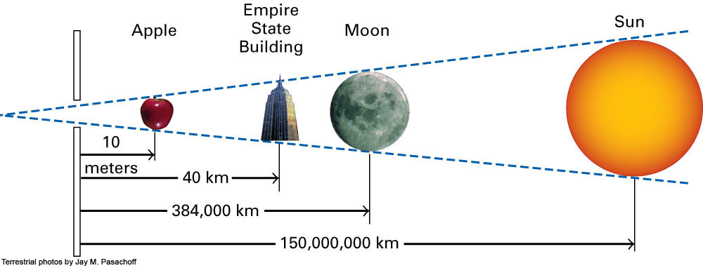
Angular Size:
© Gerard Williger 2023 U Louisville
depends on an object's physical size and distance
Angle of 0.5 deg
Not to scale!
(yards)
(25 mi.)
(248,000 mi.)
(93 million mi.)
Angular size: proportional to SIZE/DISTANCE
Moon is 400x smaller than Sun, but also is 400x closer, so they both appear about 30 arcmin across
So if Moon moves 2x farther away, would appear 15 arcmin across
Notes:
Figure 4.10: An apple, the Empire State Building, the Moon, and the Sun are very different from each other in physical size, but here they cover the same angle because they are at different distances from us.
Terrestrial photos by Jay M. Pasachoff

Slide 21
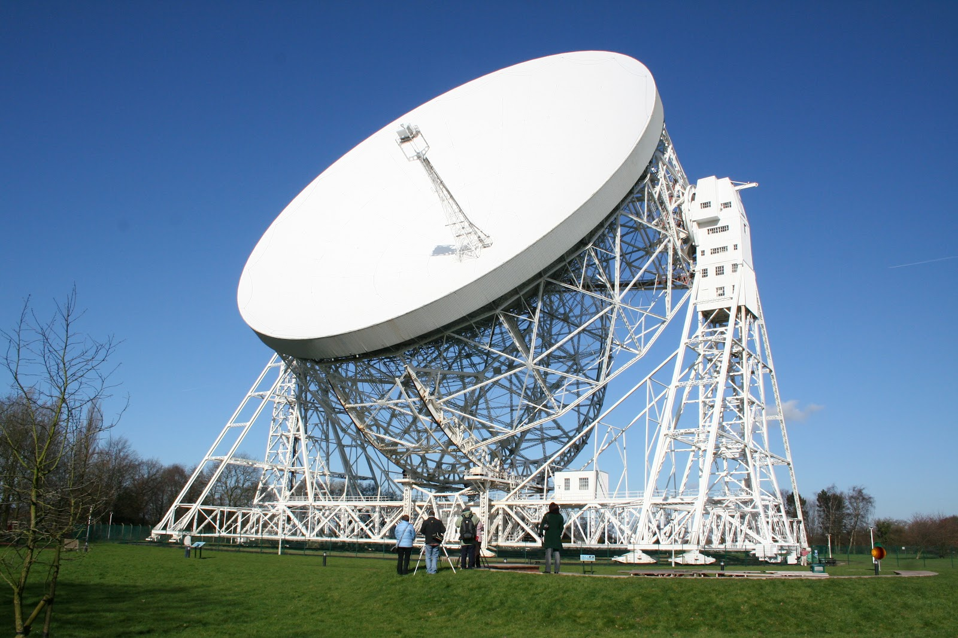
DISTANCES: How to measure them?
© Gerard Williger 2023 U Louisville
direction to star/planet EASY, distance is HARD
DIRECT METHODS:
1) Travel to astronomical objects limited to Solar System
2) RADAR bounced off Moon, most of other planets, and the Sun, measure distances by travel time
Speed x time = distance (v t = d)
Good out to Saturn
3) TRIANGULATION (“Parallax”)
Jodrell Bank Observatory, England

Slide 22
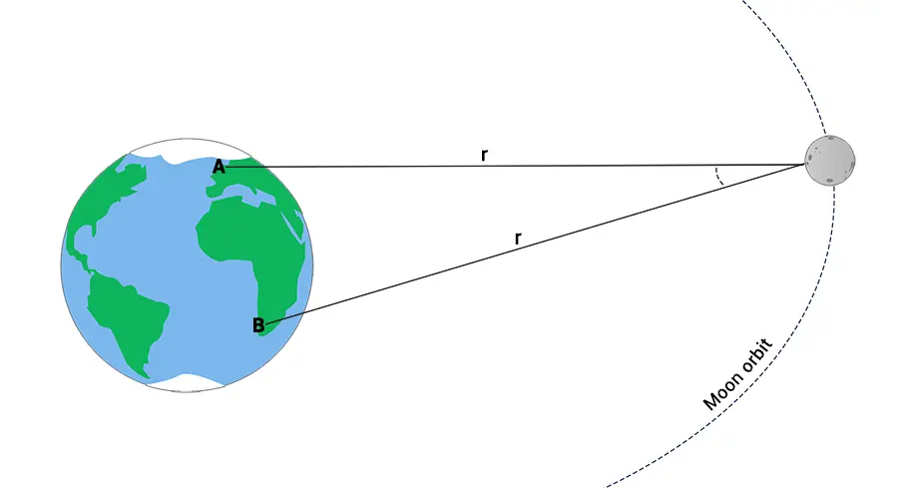
Beyond Radar I: Triangulation/Parallax
© Gerard Williger 2023 U Louisville
Triangulation (=”Parallax”): used by ancient Greeks
Calculated distance from Earth to Moon
Also calculated size of Earth by observing Sun (much farther away)
NOT to SCALE!

Slide 23
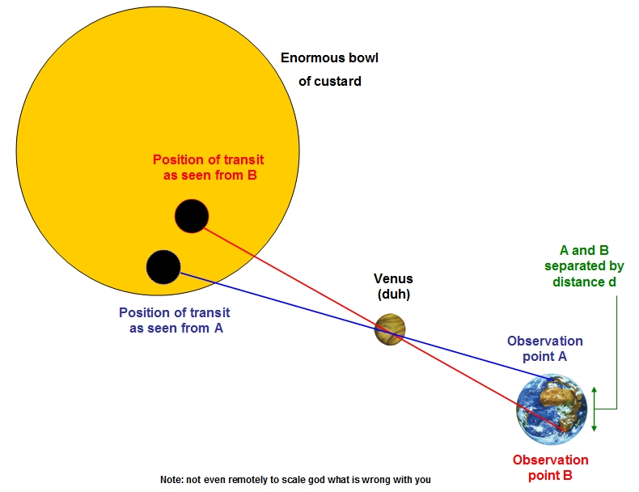
Beyond Radar II: Triangulation/Parallax
© Gerard Williger 2023 U Louisville
Triangulation (=”Parallax”): used by Captain James Cook and others, 1760s
Calculated distance from Earth to Sun, using Venus transit (“eclipse”)
Needed an accurate clock!
NOT to SCALE!

Slide 24
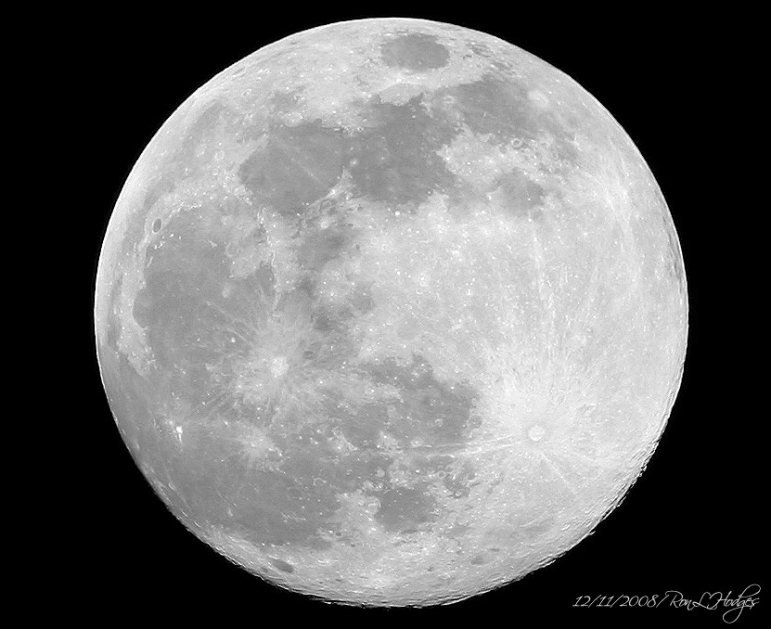
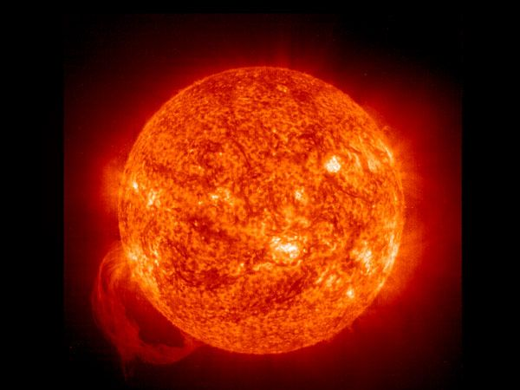
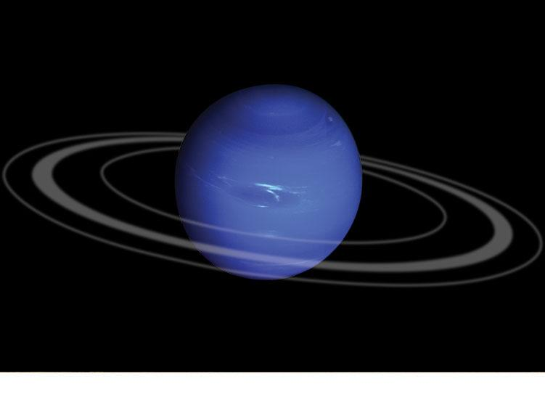
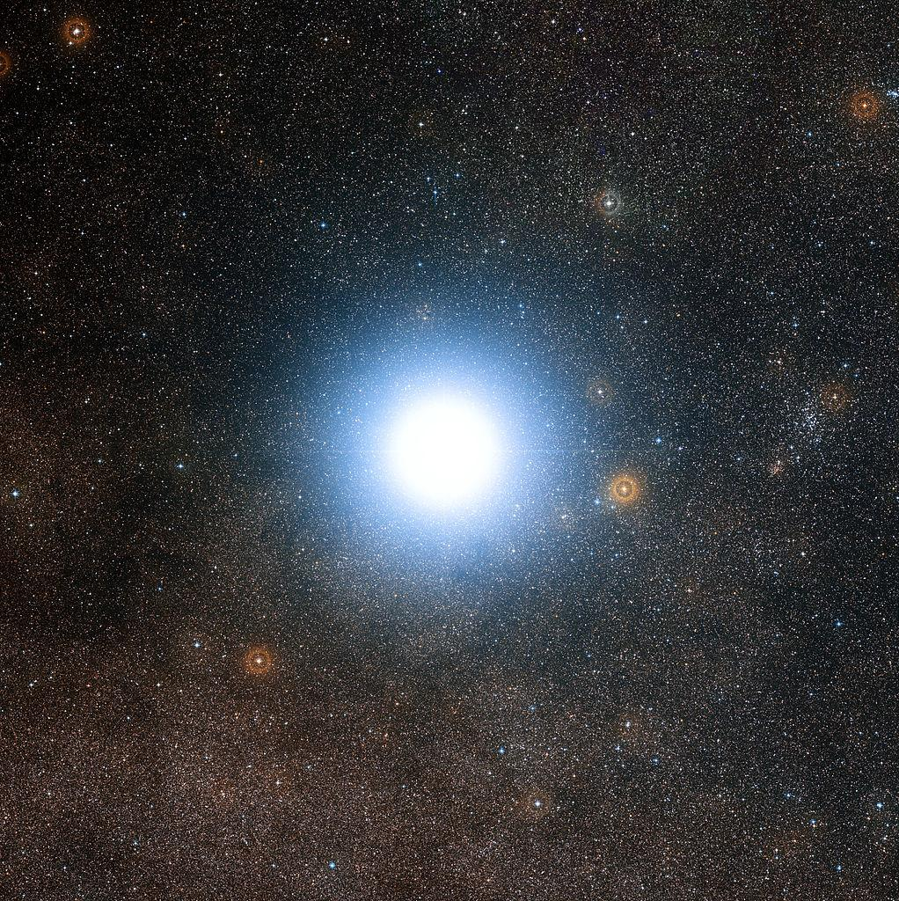
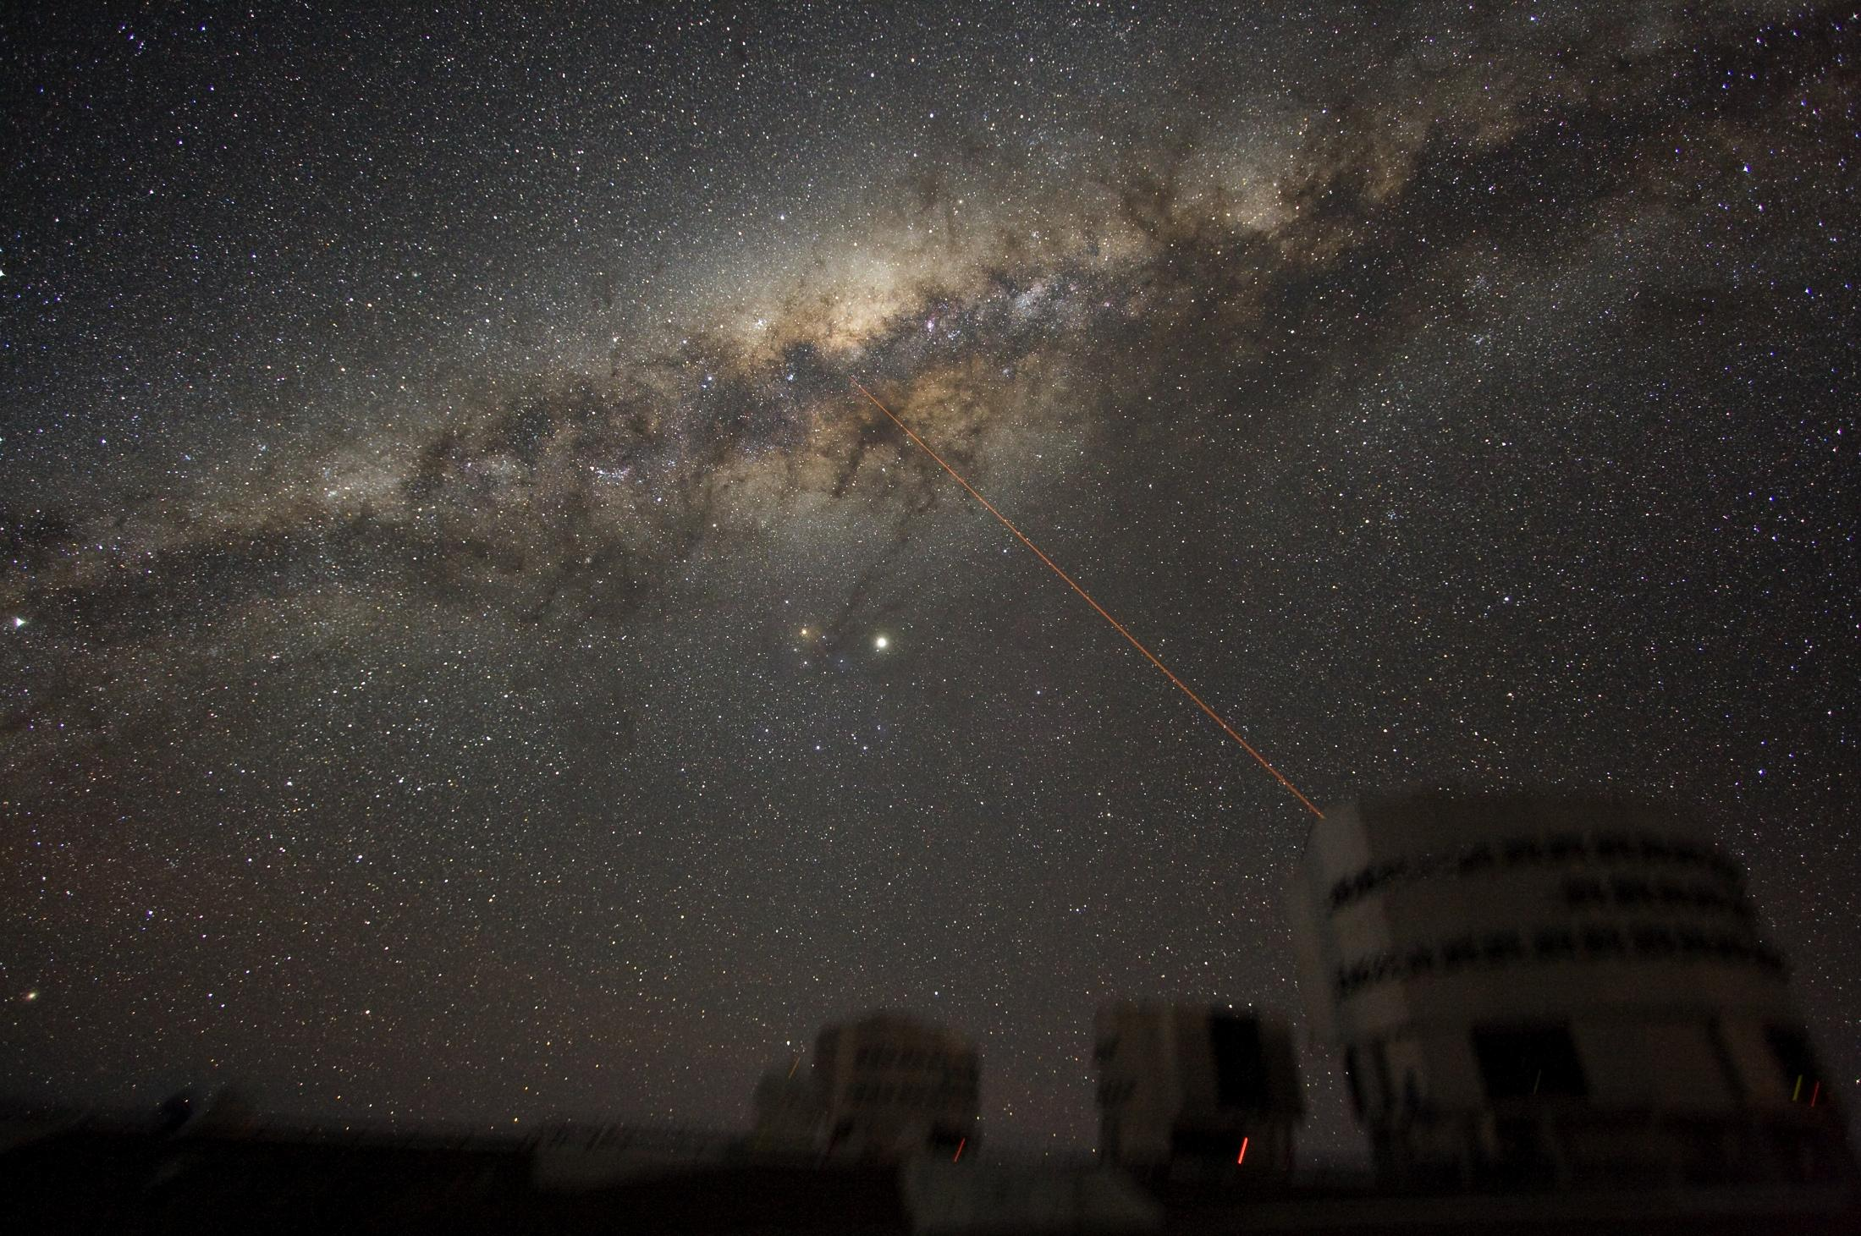
Light Travel Time to Earth from:
© Gerard Williger 2023 U Louisville
Light travels at 186000 miles/sec = 300,000 km/sec
– 7 times around Earth in 1 sec!
Moon: 1 sec
Sun: 8 minutes
Neptune: 4 hours
Alpha Centauri (nearest star): 4 yrs
Milky Way center: 30000 yrs

Slide 25
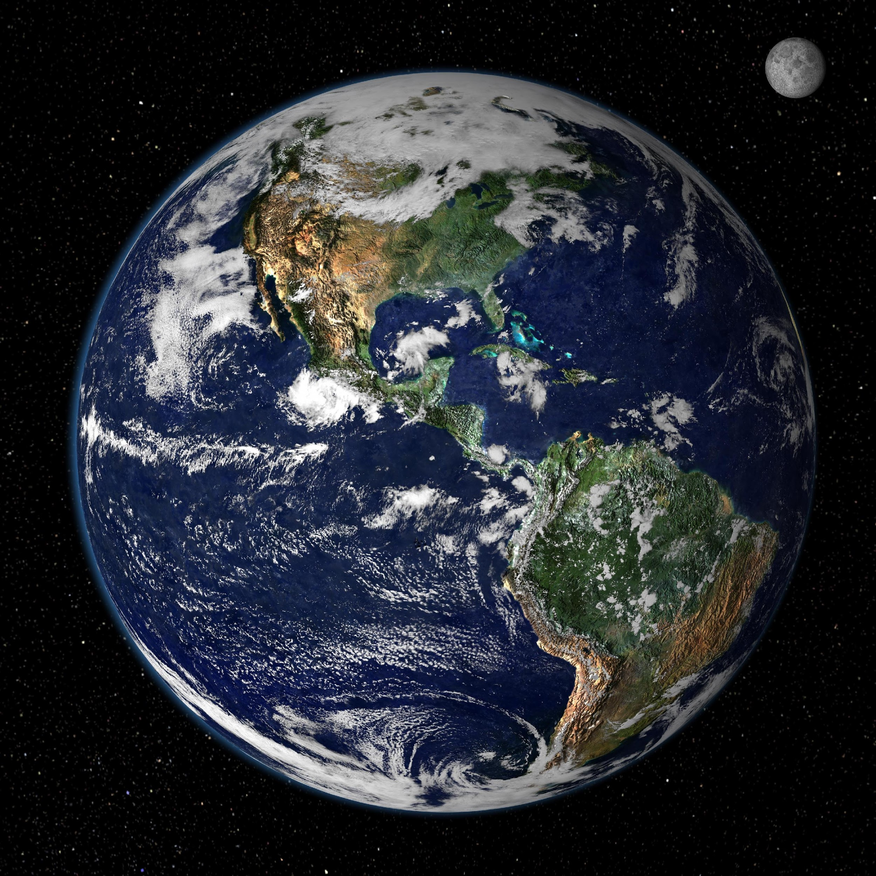

Astronomy Scales
© Gerard Williger 2023 U Louisville
Relative units: 1 Astronomical Unit (AU) = mean distance Earth-Sun, 1.5 x 10⁸ km
Mean distances: Mercury 0.4AU, Jupiter 5.2AU, Pluto 39AU, nearest star 2.7x10⁵ AU
If Earth shrunk to baseball size (4”=10cm=0.1m diameter), then what’s an AU in our “model” solar system?:
→ 1AU= 1.2km (about ¾ of a mile)
Scale down by factor of 130 million

Slide 26
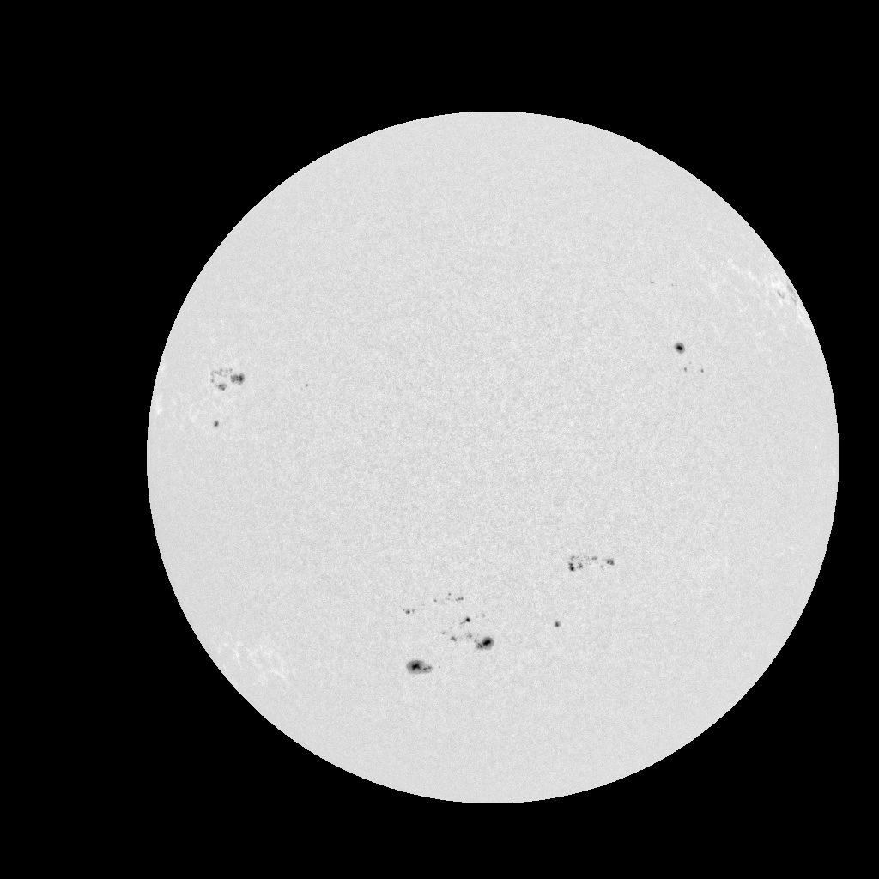
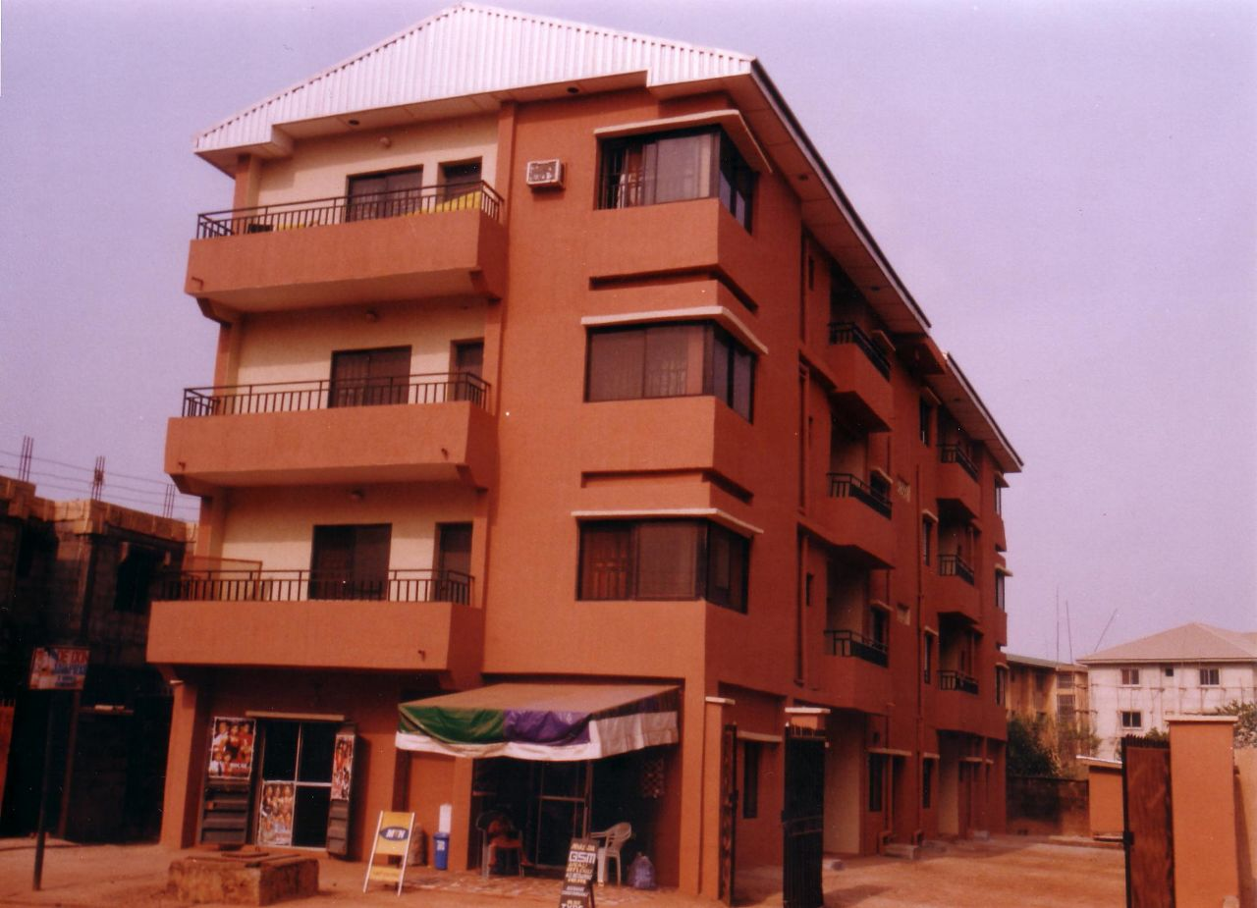
Astronomy Scales
© Gerard Williger 2023 U Louisville
In model system, “Sun” diameter is 100x D_{E} or 10m (3 stories high)!
Mercury: (0.4AU)(1.2km/AU)~0.48km from "Sun“ (5 football fields)
Jupiter: (5.2AU)(1.2km/AU)=6.2km (4 mi.) from "Sun" – to center of Louisville
Pluto: (39AU)(1.2km/AU)=47km (29 mi.) from "Sun" – to Shelbyville
Nearest star (Alpha Cen): (2.7x10⁵AU)(1.2km/AU)= 330,000 km from "Sun" or 25 Earth diameters or 3/4 of distance to Moon
Scale factor 130 million
1.2 km or length of campus!
1 AU

Slide 27
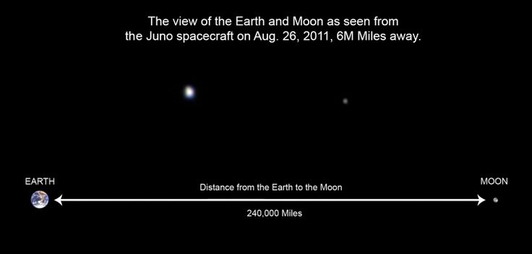
Earth-Moon System to Scale
© Gerard Williger 2023 U Louisville
If Earth were a tennis ball (6.7cm in diameter), Moon would be a marble ¼ the size, 80cm (2.7 feet) away
Earth
Moon
The Sun is 400x farther than the Moon, and 100x bigger than Earth!

Slide 28
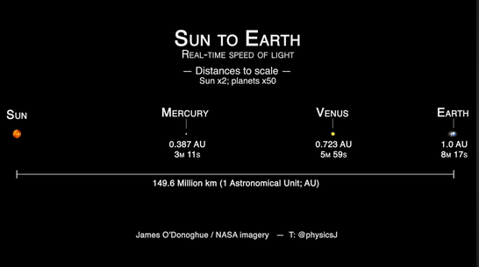
Earth-Sun System (almost) to Scale
© Gerard Williger 2023 U Louisville
Magnified 2x
Magnified 50x
Magnified 50x
Magnified 50x
If Sun were a basketball (24cm in diameter), Earth would be a pencil point (2mm diameter), 26m (30 yards) away!

Slide 29
Summary
© Gerard Williger 2023 U Louisville
Eclipse coming: total (Apr 8, 2024)
Earth both ROTATES on axis and REVOLVES around Sun
causes apparent motions of stars over a night and a year
Sun MOVES among the stars, about 1 deg to E each day
Moon MOVES among stars, about 13 deg to E each day
Astronomers measure ANGLES
Distances HARD to measure
Space is **BIG** -- most figures NOT TO SCALE

